Slide 1
I messed up
This is an apology.
I research the heck out of my talks and take pride in the quality of the product of that work. I tend to pick topics that require a fair bit of research because that’s what motivates me. I missed the mark, however, when talking about autoboxing and unboxing of primitive types in Java.
The object conversion issue is one that can hurt you in most languages, but I didn’t want this to be just a C# talk. Remembering back to my two years as a Java programmer, this issue came to mind. I searched the web to see if the situation had changed, but my terminology was not precise enough to give me the answer I needed. Instead, I gravitated toward the answer I wanted (to make my job easier).
Just so I can be 100% clear. Boxing and unboxing primitives in Java happens if the parameter type is mismatched with the variable. It is not a normal problem in Java but can be an insidious one when it occurs. It certainly doesn’t happen as I described it.
Anyway, because I owe it to the community, I’ll leave this deck otherwise untouched, but will follow up with a detailed blog post for wonks like me. Check https://m.eado.ws/blog for this and other upcoming posts.

Slide 2

Ignoring Nulls
And Five Other Horrible Things Most Developers Do
AKA
The Seven Deadly Sins of Programming

Slide 3

But Wait…

Slide 4

About Me
Michael Meadows (he/him)
Father, husband, trans rights ally, advocate for the unhoused
Architect at Insight Consulting
Aspirational sea kayaker

Slide 5
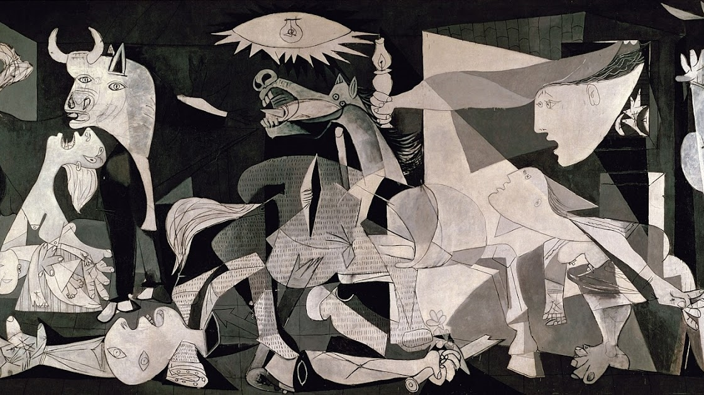
NOT the Venue for a Language Holy War
This Photo by Unknown Author is licensed under CC BY-NC-ND

Slide 6
Seven Deadly Programming Sins
Language-Driven Bad Practices
Misusing Exceptions
Underestimating the Impact of Objects on Memory Management
Everything Related to Strings
High Mental Load
Ignoring the Complexity of Null
Trying to Simplify Date/Time
Everything Related to Logging
And…
Being dogmatic about any of the above

Slide 7

No. First, Let’s Talk About
Two reasons really…
Language-Driven Bad Practices
Why do we do these things?
High Mental Load

Slide 8
Seven Deadly Programming Sins (joke slide)
Language-Driven Bad Practices
Misusing Exceptions
Underestimating the Impact of Objects on Memory Management
Everything Related to Strings
High Mental Load
Ignoring the Complexity of Null
Trying to Simplify Date/Time
Everything Related to Logging
And…
Being dogmatic about any of the above

Slide 9

Language-Driven Bad Practices
Not just for n00b$!

Slide 10

Exceptions Are Your Enemy
… except when you follow this advice

Slide 11

… except when you need an escape route
Special (exceptional) control flow
Interrupts current execution when there is no better way out
Built-in signaling and filtering in most languages

Slide 12

Halt and Catch Fire – A brief history
HCF

Slide 13

Exceptions be like…

Slide 14
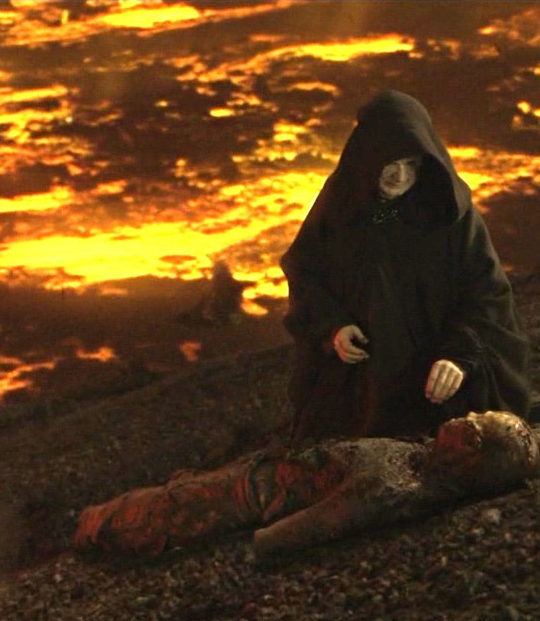
… except when they burn you
Use in non-exceptional control flow
Reliance on the message
Catch-log-throw
Swallowing whole (and its variants)
As a substitution for a return value
This Photo by Unknown Author is licensed under CC BY-SA

Slide 15
Exception Example: So Many Bads
function Find(values) {
let retval;
try {
for (i = 0; i < values.length; i++) {
retval = FormatValue(values[i]);
}
} catch (error) {
if (typeof retval === 'undefined') {
throw error;
}
}
return retval;
}
function FormatValue(value){
if (value) {
return `Value is: ${value}`;
}
throw "The value is empty";
}
console.log(Find(["muh", "buh", "wuh"]));
// "wuh"
console.log(Find(["duh", null, "guh"]));
// "duh"
console.log(Find([null, "yuh"]));
// exception "The value is empty"

Slide 16
Exception Example: Many Less Bads
function Find(values) {
let retval;
for (i = 0; i < values.length; i++) {
let value = values[i];
if (!value) {
return retval ? retval : null;
}
retval = FormatValue(value);
}
return retval;
}
function FormatValue(value) {
return `Value is: ${value}`;
}
console.log(Find(["muh", "buh", "wuh"]));
// "wuh"
console.log(Find(["duh", null, "guh"]));
// "duh"
console.log(Find([null, "yuh"]));
// null

Slide 17
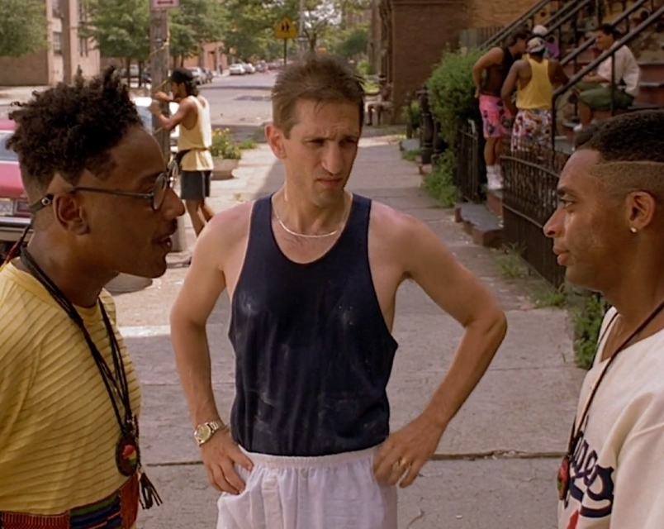
… except when you do it right
Only handle ASAP or last-chance
Use to indicate to the program that a situation was
Unforeseen and therefore not coded
Foreseen, but beyond the scope of the executing code

Slide 18


Underestimating the Impact of Objects on Memory Management
Objects are a heap of trouble

Slide 19

Objection, hearsay
Everything is an object – Java 1996
Object-oriented programming offers a sustainable way to write spaghetti code. It lets you accrete programs as a series of patches. – Paul Graham 2004
Actually, I made up the term "object-oriented", and I can tell you I did not have C++ in mind. – Alan Kay 1997
Fowler’s law is invoked when you have a penetrating insight into object-oriented programming. If the quality of your insight is very high, you realise (sic) that Martin Fowler published the idea only five years ago. If the idea is poor, you realise (sic) that he published your idea more than 10 years ago… to demonstrate how many people still don’t get it. – nomorehacks 2009

Slide 20

Objection, irrelevant
In languages where this is an issue, your use case may not demand optimization
Some languages are evolving to move more state bags to the stack. Use with caution
If you’re not sure, side with simplicity, plan a load test, and let the profiler tell you what you need to do

Slide 21

Objection, speculative
Garbage collection is your best friend and your worst enemy!
In high scale systems, memory is the long pole in the performance tent
Frequent garbage collection also taxes CPU

Slide 22

Objection, best evidence
Don’t be afraid to use singletons where they make sense
If you’re using dependency injection, take some time to understand the lifecycle of injected objects
If your language offers structured value types (e.g., structs), use them when they make sense
Transient objects should truly be transient so that your garbage collection can more easily free up memory
Understand the consequences of primitive boxing

Slide 23
Examples: Everything is an Object!
Read this blog post by Cameron McKenzie. He talks about the cost of autoboxing https://www.theserverside.com/blog/Coffee-Talk-Java-News-Stories-and-Opinions/Performance-cost-of-Java-autoboxing-and-unboxing-of-primitive-types
A mountain a pile of heap of garbage to be collected
public string doThisIneffeiciently(int foo, boolean bar) { return getResult(foo, bar, "steve"); }
public String getResult(int foo, boolean bar, String baz) { return bar ? String.format("%s", foo) : baz; }

Slide 24

Example: If Everything is an Object, Lean In
class FooHelper { boolean bar; int foo; public FooHelper(boolean bar, int foo) { this.bar = bar; this.foo = foo; }
public String doThisIneffeiciently() { return getResult("steve"); }
private String getResult(String baz) { return bar ? String.format("%s", foo) : baz; } }

Slide 25
Example: Or Just Get More Functional
private const string Steve = "steve";
public static string DoThisMoreEfficiently(int foo, bool bar)
{
return bar switch
{
true => FormatFoo(foo),
_ => FormatBaz(Steve)
};
}
private static string FormatFoo(int foo) => foo.ToString();
private static string FormatBaz(string baz) => baz;

Slide 26


Strings are Objects…
... that are arrays of characters

Slide 27

… that all trace back to C
A string in ANSI C char string1[20] = { "A", " ", "s", "t", "r", "i", "n", "g", "\0" };
Or char string2[20] = "A string";
#ThankYouAnsiC

Slide 28

… but Worse (and better)
Modern languages optimize strings to make them immutable
Every variable assignment to string allocates memory
This is powerful in many cases, but can be evil if you’re not careful

Slide 29


… that are Often Used Inefficiently
Transitional states (string building)
Frequent reassignment
Not using symbolic constants
Formatting

Slide 30

… that Need Some Love and Care
Use a string builder if available
Avoid creating unique strings in high volume methods/functions
Don’t use strings to convey unique data or state unless they’re constants
Be aware of the impact of logging on string creation

Slide 31

High Mental Load
For high mental developers!

Slide 32

Null is Never your Friend
Except when it is, but we’ll talk about that later
Also… Except when cribbed from Tony Hoare’s 2009 talk at Qcon (https://www.infoq.com/presentations/Null-References-The-Billion-Dollar-Mistake-Tony-Hoare/)

Slide 33
background: null
Called the “billion-dollar mistake” by Tony Hoare, who was credited for the creation of null.
Originally, null was a pointer without a value
Has evolved to mean “no value assigned” in memory managed languages
Does not apply to value types (see section on objects)

Slide 34
problem := null
Lacks any semantic meaning (other than that the pointer has no reference)
Requires null checks everywhere
What do you do if it’s null?

Slide 35
language.solve(null)
Null vs Undefined
Structs
Compile-time null checking
Discriminated unions

Slide 36
Traditional (pseudocode)
function get_book(id:number): book
retrieve record from database by id
if record does not exist return null
else return book
end function
my_book = get_book(1)
if my_book is null print “book not found”
else print “book found”

Slide 37
Discriminated Union (pseudocode)
function get_book(id:number): no_book or book
retrieve record from database by id
if record does not exist return no_book
else return book
end function
get_book(1)
when no_book print “book not found”
when book print “book found”

Slide 38
Discriminated Union(ish) C#
public OneOf<Book, NoBook> GetBook(string id)
{
Book book = _repo.GetBookById(id);
if (book == null)
{
return NoBook.Instance;
}
return book;
}
var result = GetBook(1);
Console.WriteLine(result.Match(
book => "book found",
noBook => "book not found"));

Slide 39
null < best_practices
Use what the language brings
Check for nulls at system boundaries, avoid them internally
Interrogate and remediate every line of code that returns null
Assign default object references instead of null (see null object pattern)

Slide 40
Null Object Pattern (c#)
public interface IBookshelf
{
Book FindBook(string id);
}
public class NullBookshelf : IBookshelf
{
public Book FindBook(string id) => Book.NoBook;
}

Slide 41


Time is the Enemy
It is, in fact, a piece of wax falling on a termite who’s choking on the splinters

Slide 42

Is [not] On My Side
Instant in time
Impossible when accounting for Clock Skew and Relativity
An instant in time at a specific place
Geographic time
An instant in time in a specific time zone
Time zones are political
An instant in time as an offset of UTC
DateTime with offset
Conceptual time
Loose communication of time

Slide 43

Keeps on Slippin’ Slippin’
We rely on our intuition to reason about time
We don’t have a good [human] language for expressing time precisely
Most programming languages/frameworks do a terrible job clarifying
Time zones are political
Cultural differences in things like age calculations

Slide 44


Does Anybody Really Know What Time it Is
Commissions are paid every Thursday
Which time zone? UTC, head office TZ, employee’s TZ
That occurs daily at exactly 4:45AM EST
Historically, this is a mess because geographic affinity to a time zone changes over time
First commit wins
Clock skew and relativistic time make this an ugly mess
That transaction happened at 01:21 -07:00
Offsets are no better than UTC when stored on disk. The further ahead or behind we do math on this, the less likely it is to be relevant to the observer who recorded it (i.e., time zone changes, daylight saving)
Children can create an account when they turn 13
Under which reckoning (e.g., Western, East Asian)

Slide 45

Waiting for someone or something to show you the way
Within systems, use epoch timestamps (long integers) if you’re able
Always store time as UTC or epoch timestamp (long integer)
Time zones are a localization concern and should be left to the front-end
If needed, store event Time Zone information as separate field with the record
Never use offsets
Don’t underestimate the complexity of dealing with time in your designs

Slide 46

Logging and Logging and Logging
{"date":"05/05/23 12:45:56","severity":"ANY","message":“starting logging"} {"date":"05/05/23 12:45:57","severity":"ANY","message":“logging"} {"date":"05/05/23 12:45:57","severity":"ANY","message":“finishing logging"} {"date":"05/05/23 12:45:57","severity":"INFO","message":“logging complete"}

Slide 47

[12:45:12 INF] We need to log this
[12:45:50 WRN] Troubleshooting a specific issue
[12:51:30 INF] Capture context for inspection
[12:49:00 VRB] Trace a request across services
[12:55:02 FTL] Build metrics (after the fact)
[12:47:12 ERR] Log that one error in every method in the stack

Slide 48
[13:05:00] TRACE Have a Plan
[13:05:00] WARN Log consistently (not profusely)
[13:05:01] ERROR Don’t log errors reflexively
[13:05:01] INFO Think about performance
[13:05:01] INFO Use log context scope rather than formatted log message
[13:05:05] TRACE Event ids > message

Slide 49
Don’t Count Your Eggs (Unless They’re Aggregated)
{
"series": [
{
"metric": "pay_attention",
"points": [
{
"cheaper_than_logging": 1,
"proves_system_function": 2,
"fancy_gauges_look_cool": 3
}
]
}
]
}

Slide 50
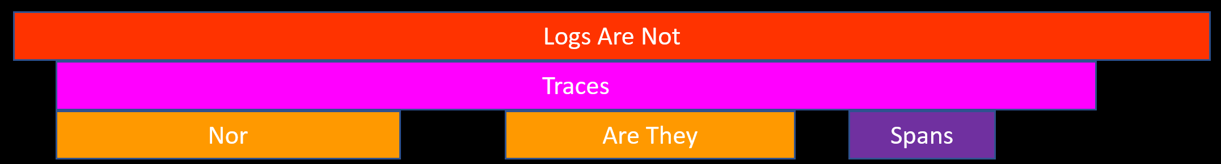
Logs are not traces, nor are they spans
Traces and distributed traces provide far better visibility across large codebases or multiple services
Flame charts make it easier to spot bottlenecks
A trace is the “vertical” execution – a stack of dependencies
A span is the “horizontal” execution – the traces over time
Most modern runtimes allow transparent configuration of tracing

Slide 51

You Don’t Have to Reinvent the Wheel
Most application performance monitoring (APM) products provide agents that can inject metrics and traces
OpenTelemetry is on the rise
Many packages exist to help minimize the mental load

Slide 52

Conclusion
https://m.eado.ws/s/2023/stirtrek
Also, DALL-E doesn’t always hit the mark.

